Slide 1
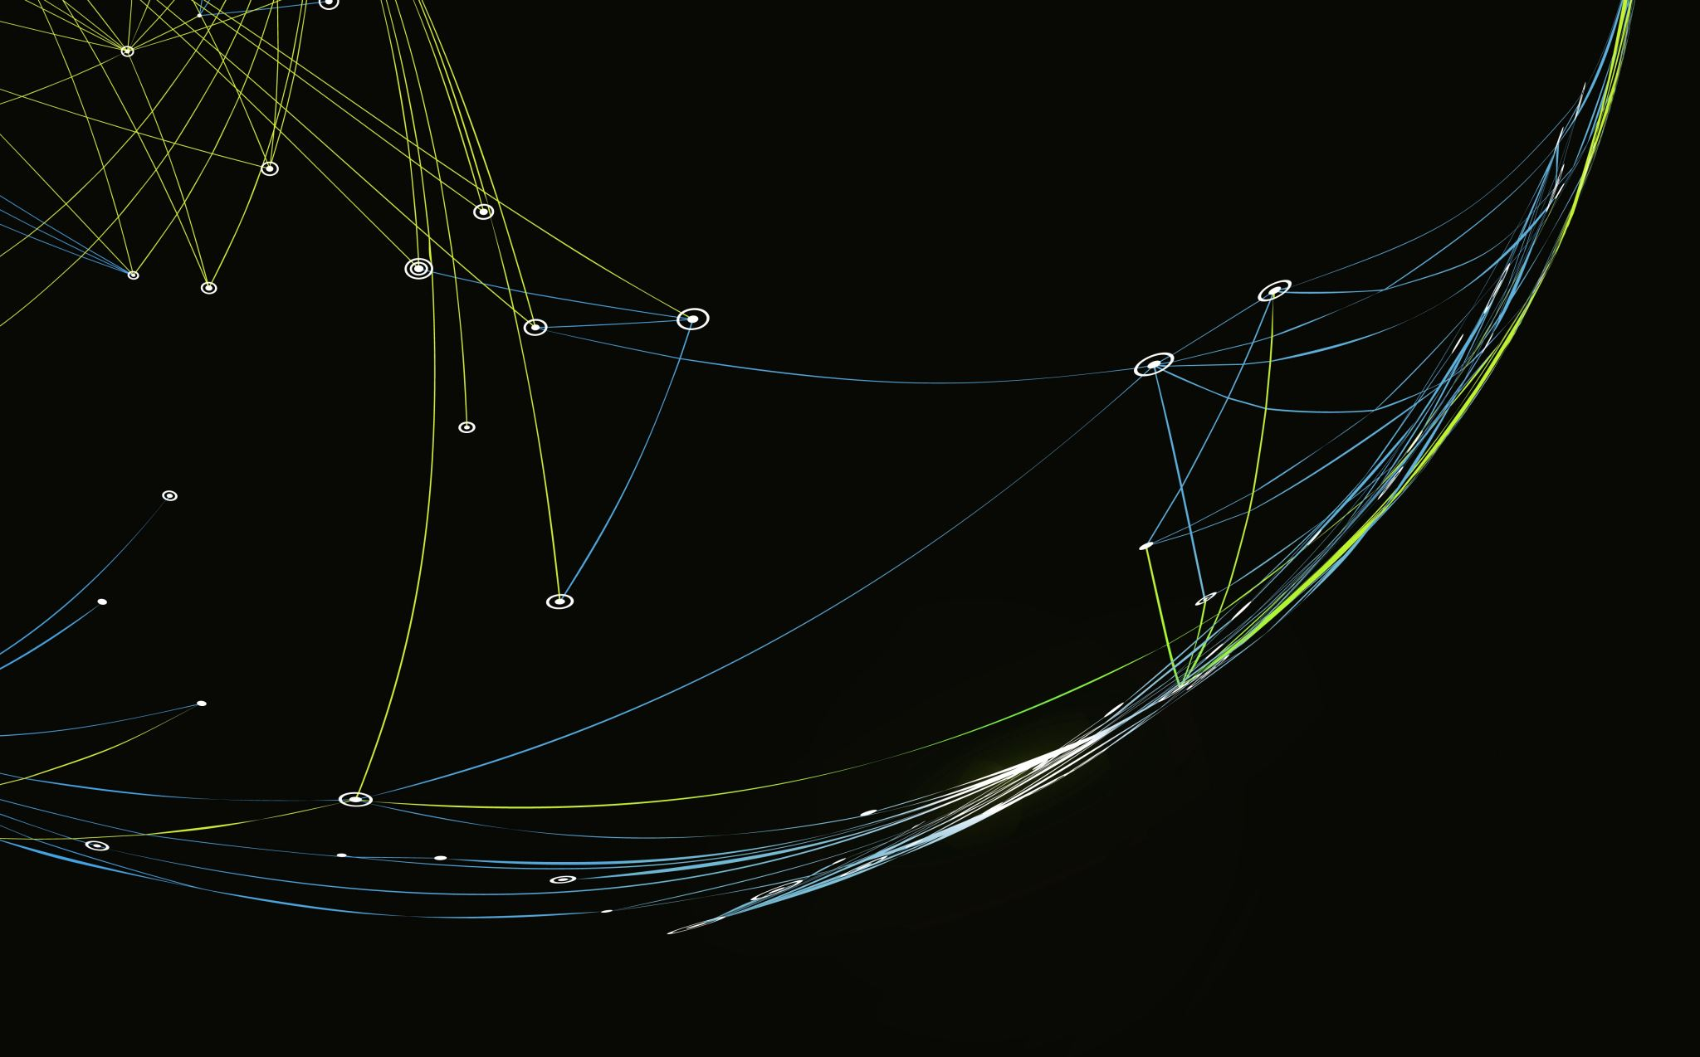
HEART FAILURE PREDICTION
TEAM WORK:
Ali Ahmed ALI FADLOUN 4230170
Haydi Ahmed 4230047
Malak Mohamed 4230029
Mostafa Mohamed 4230165

Slide 2
Introduction
Heart failure is a serious health problem that affects millions of people around the world. It happens when the heart can't pump enough blood to the body, which can lead to serious complications and even death—especially in older people and those with other health issues.
Even though medicine has improved, it's still very important to detect heart failure early and know which patients are at higher risk.
In this project, we use real patient data and machine learning to:
Understand patient characteristics
Find patterns related to death risk
Build models that predict which patients are most at risk
Discover the most important factors affecting survival
This helps doctors make better decisions, treat patients earlier, and improve healthcare overall.

Slide 3
Define the problem
🔍 Predicting Mortality Risk in Heart Failure Patients
In simple terms, the goal is to use real clinical data to:
Understand which factors are most related to patient death
Identify high-risk patients early
Support doctors in making better, faster treatment decisions
⚠️ Why This Problem Matters:
Heart failure is a serious and chronic condition with high mortality rates, especially in older adults and those with other diseases.
Early prediction can save lives and reduce hospital pressure.
Machine learning helps analyze large amounts of data and find hidden patterns that doctors might miss.

Slide 4
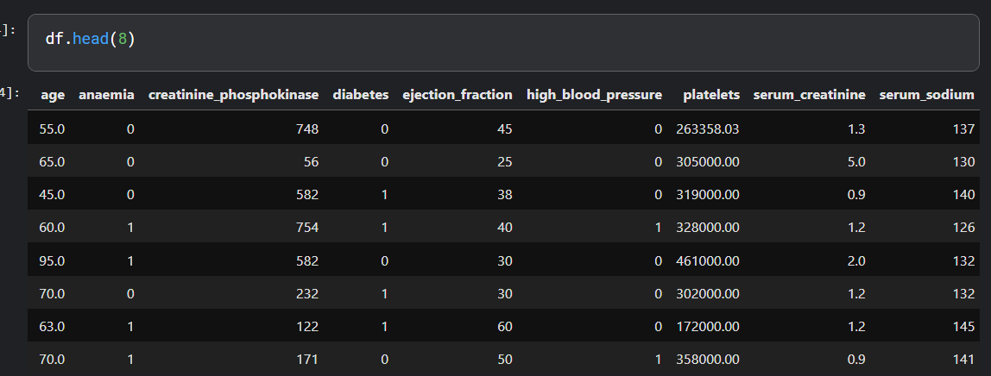
Data collection
https://www.kaggle.com/code/mostafamohamed452/heart-failure-prediction-project

Slide 5
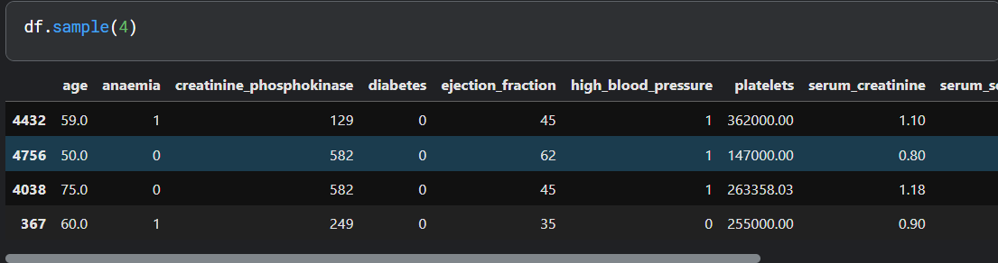
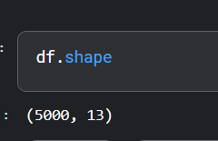
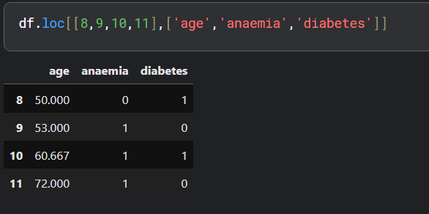
DATA representation

Slide 6
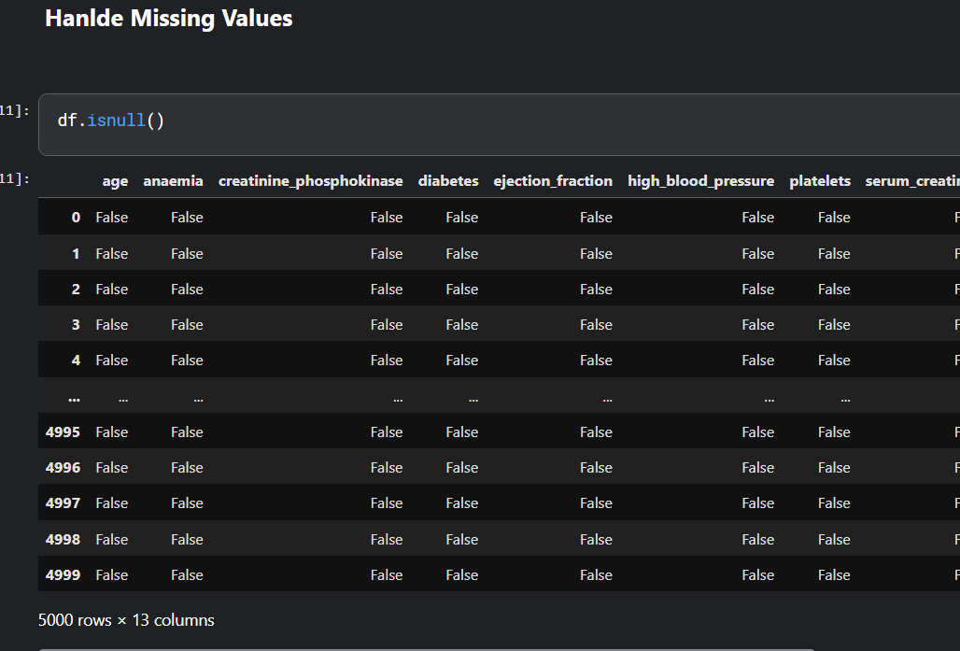
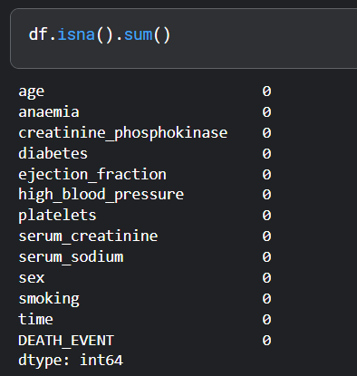
DATA WRANGLING

Slide 7
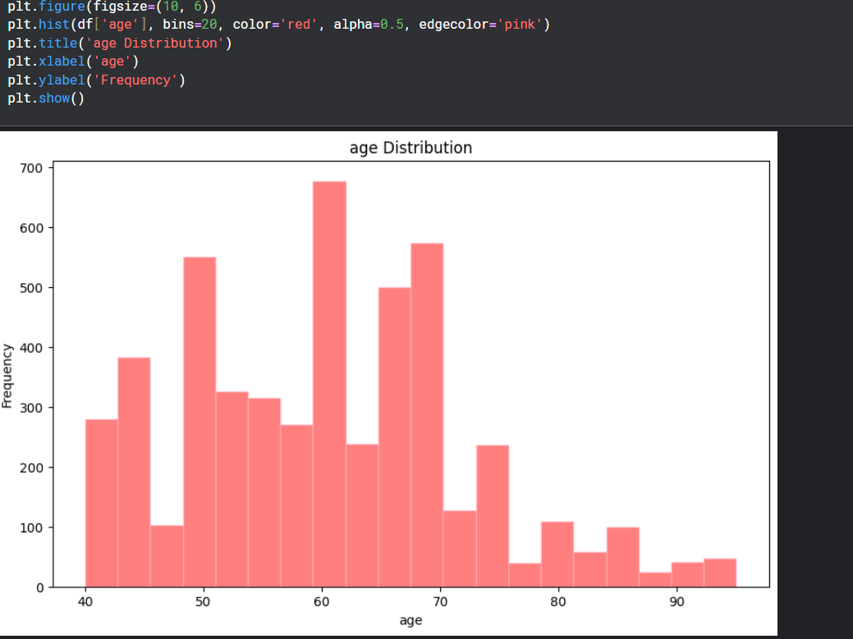
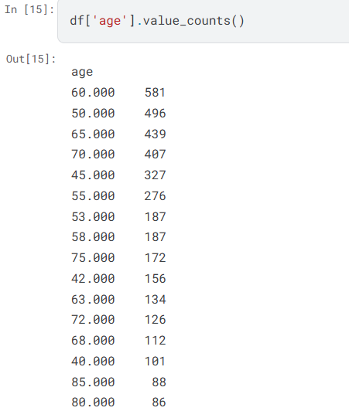
DATA ANALYSIS

Slide 8
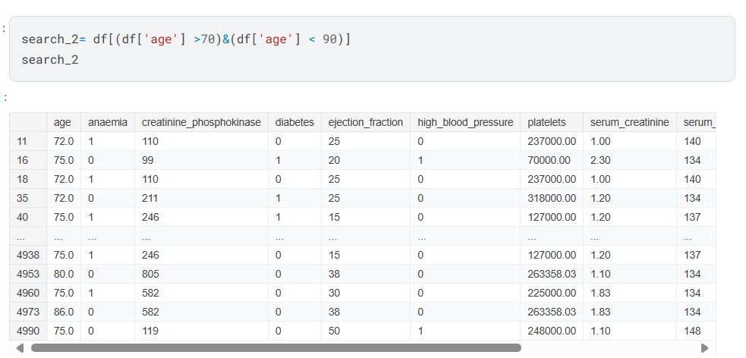
DATA ANALYSIS

Slide 9
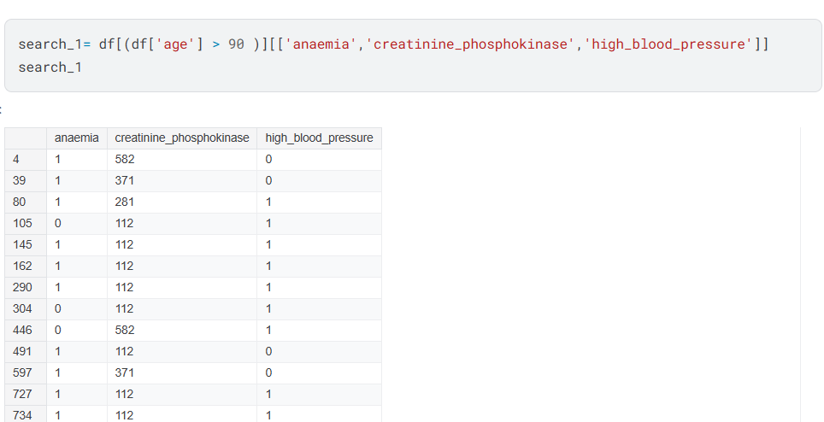
DATA ANALYSIS

Slide 10
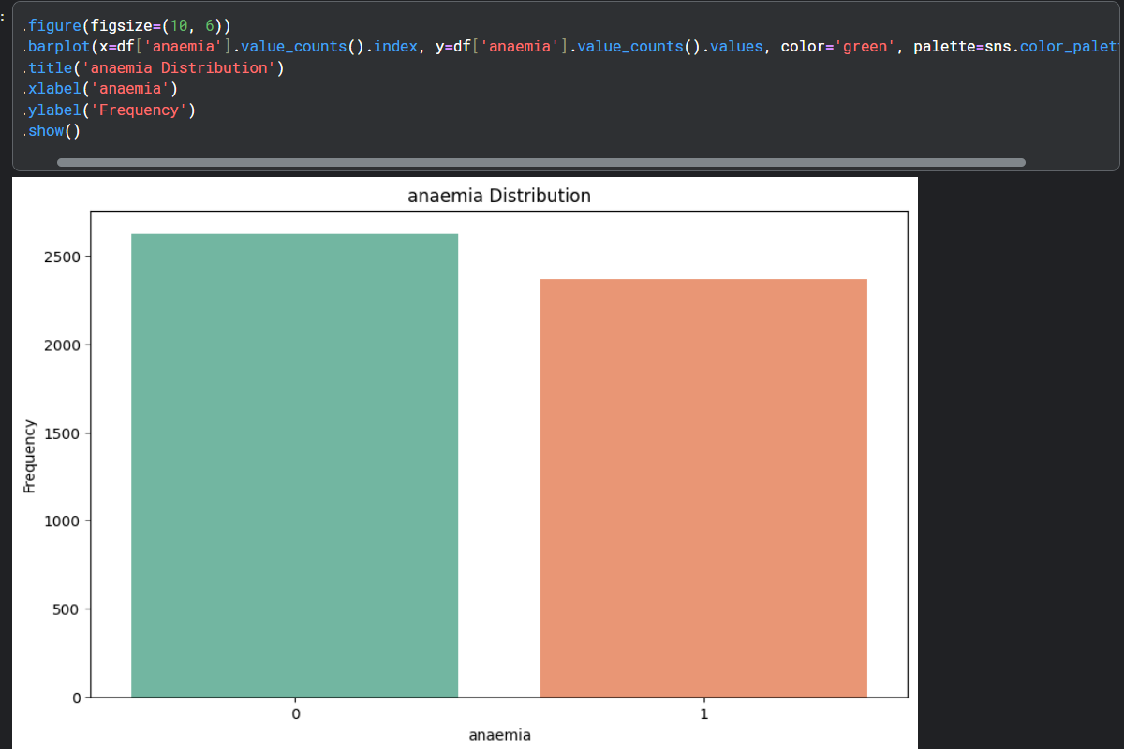
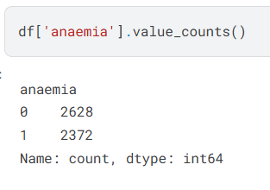
DATA ANALYSIS

Slide 11
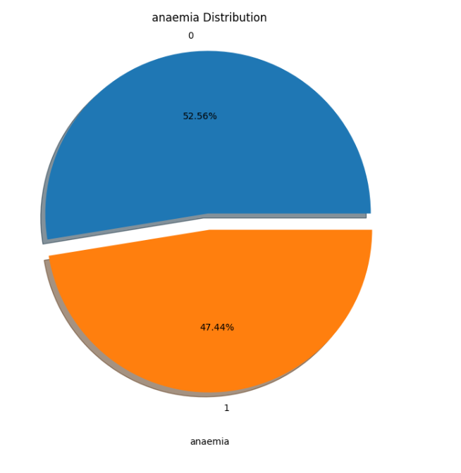
DATA ANALYSIS

Slide 12
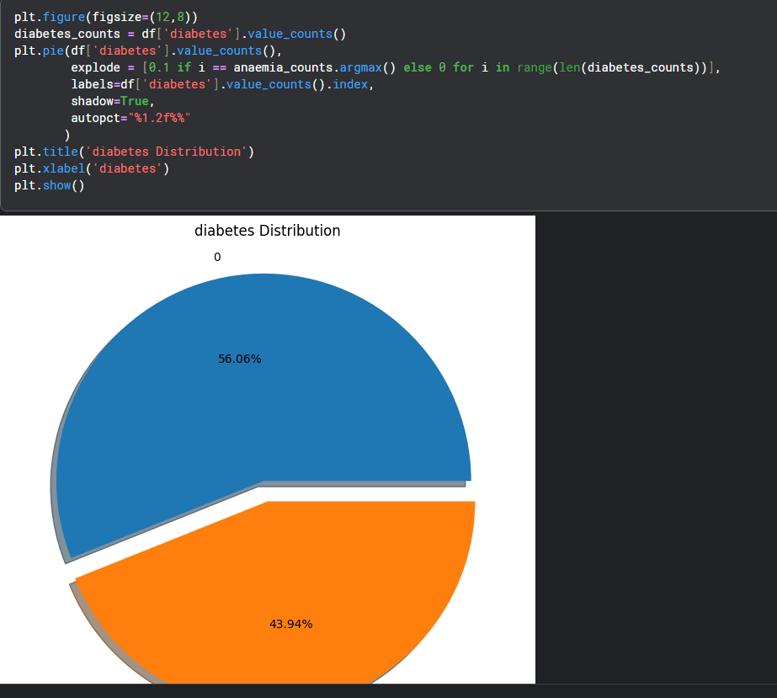
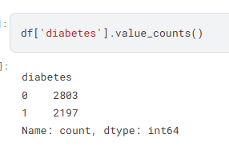
DATA ANALYSIS

Slide 13
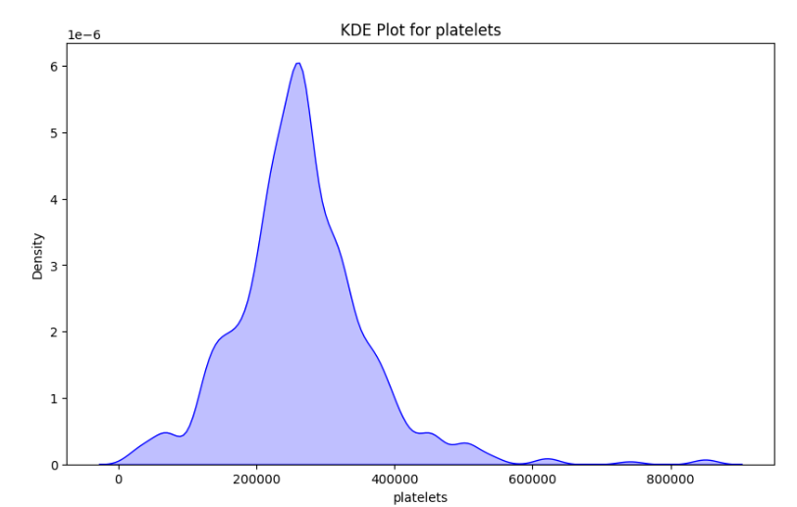
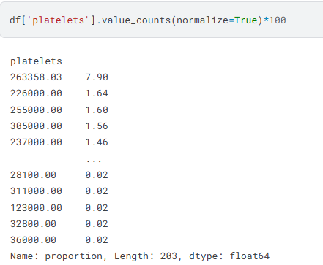
DATA ANALYSIS

Slide 14
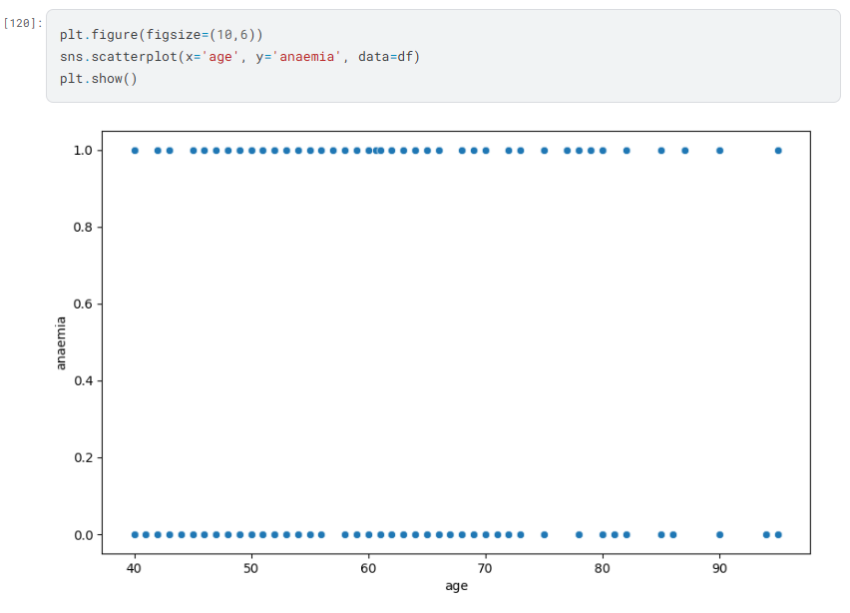
DATA ANALYSIS

Slide 15
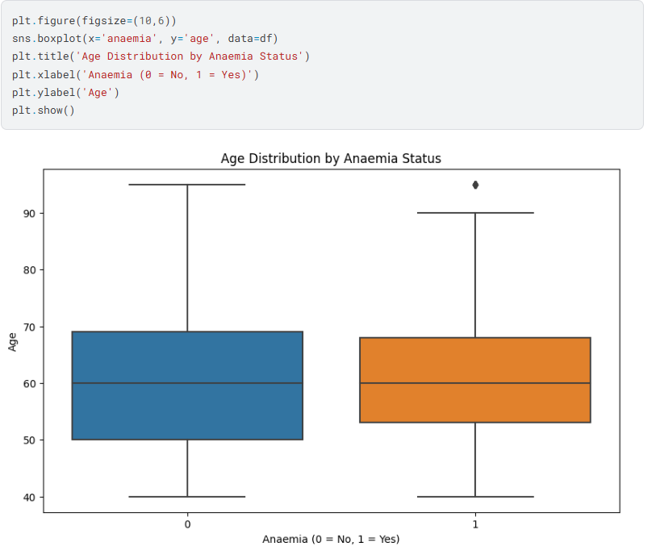
DATA ANALYSIS

Slide 16
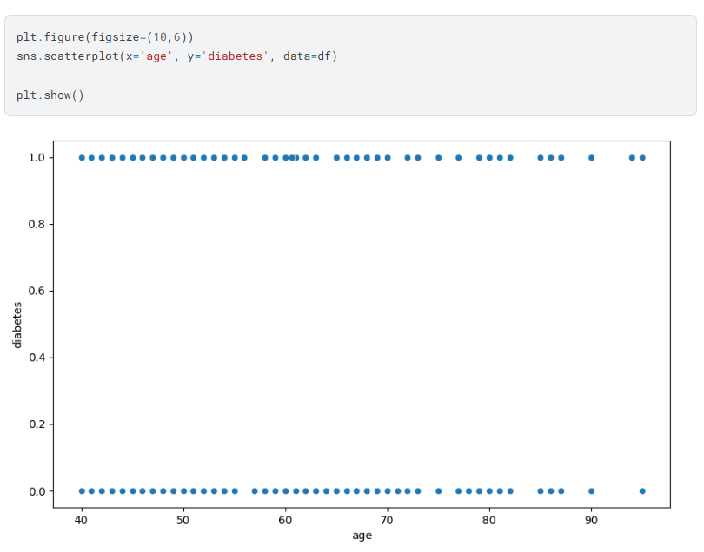
DATA ANALYSIS

Slide 17
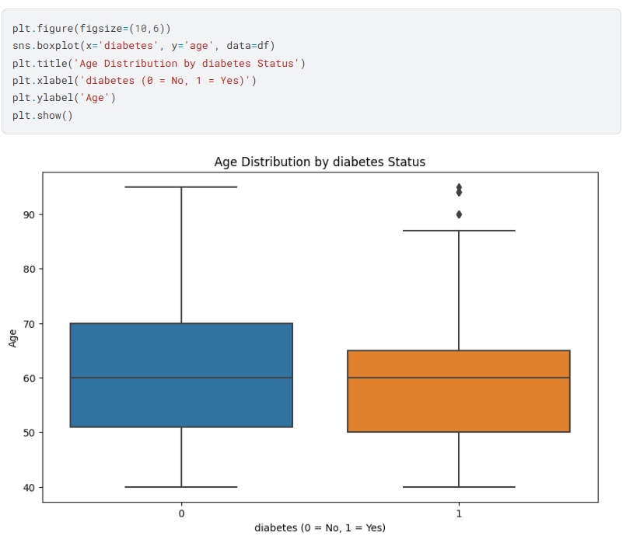
DATA ANALYSIS

Slide 18
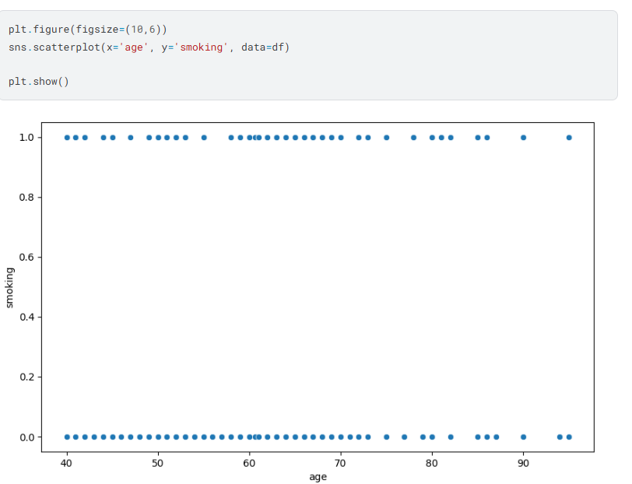
DATA ANALYSIS

Slide 19
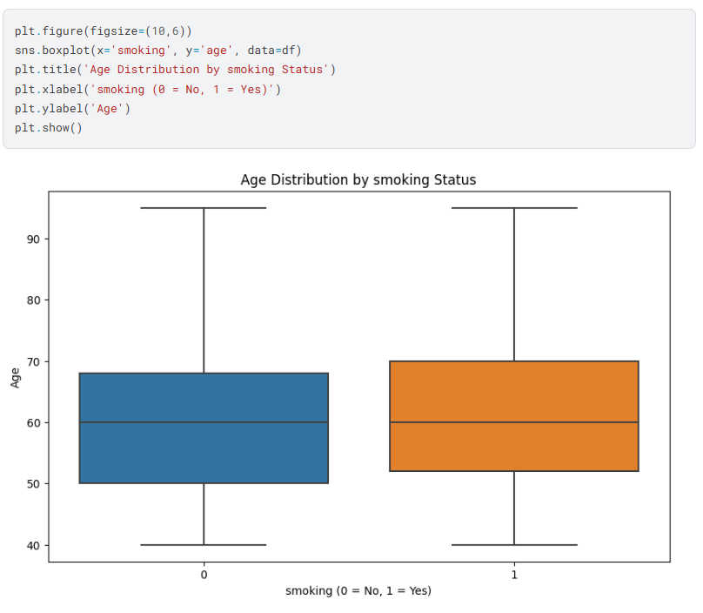
DATA ANALYSIS

Slide 20
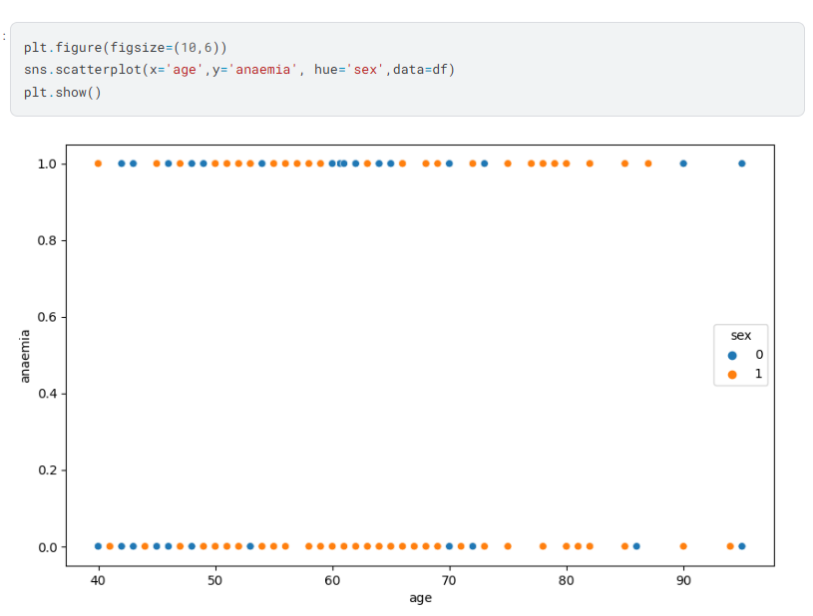
DATA ANALYSIS

Slide 21
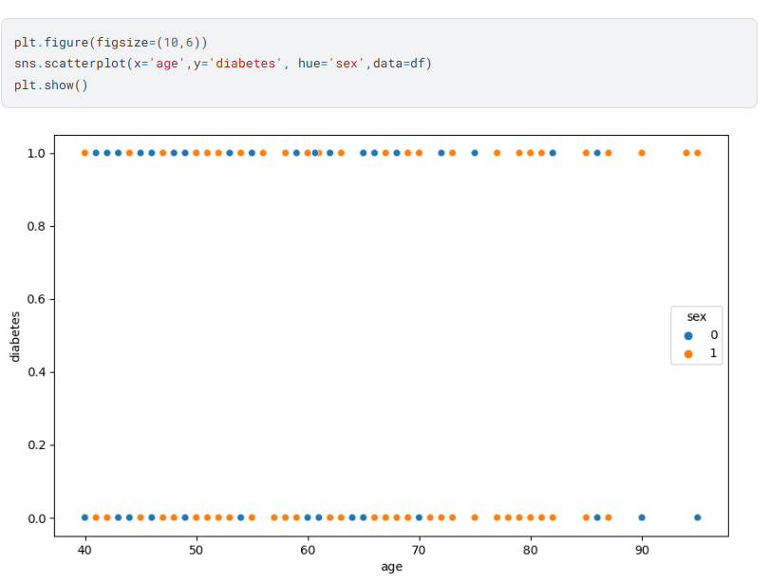
DATA ANALYSIS

Slide 22
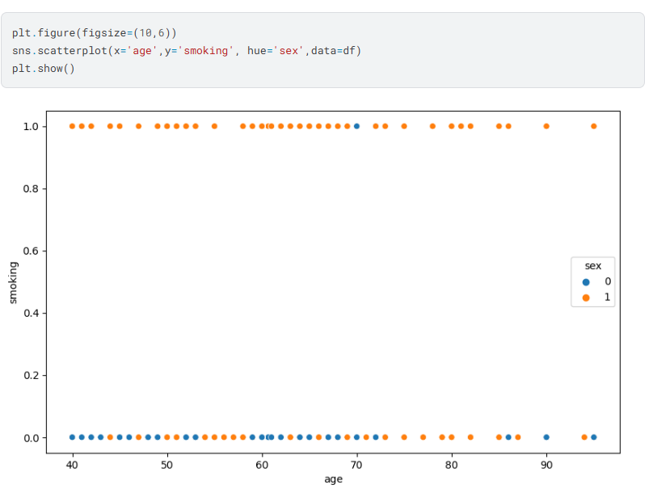
DATA ANALYSIS

Slide 23
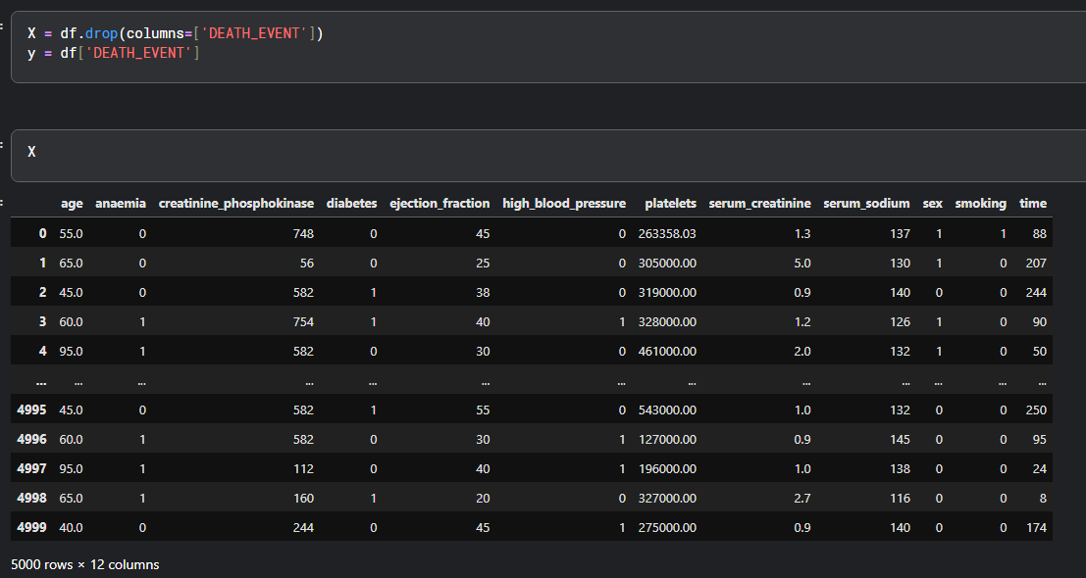
DATA PREPROCESSING

Slide 24
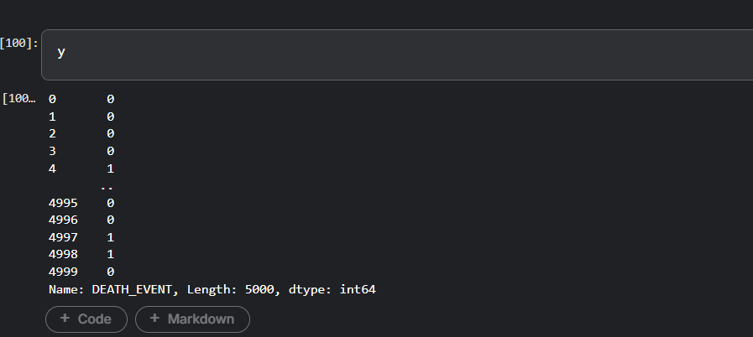
DATA PREPROCESSING

Slide 25
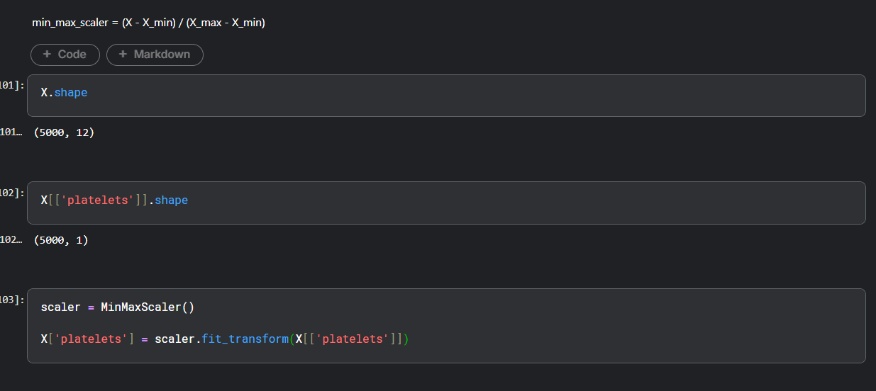
DATA SCALLING

Slide 26
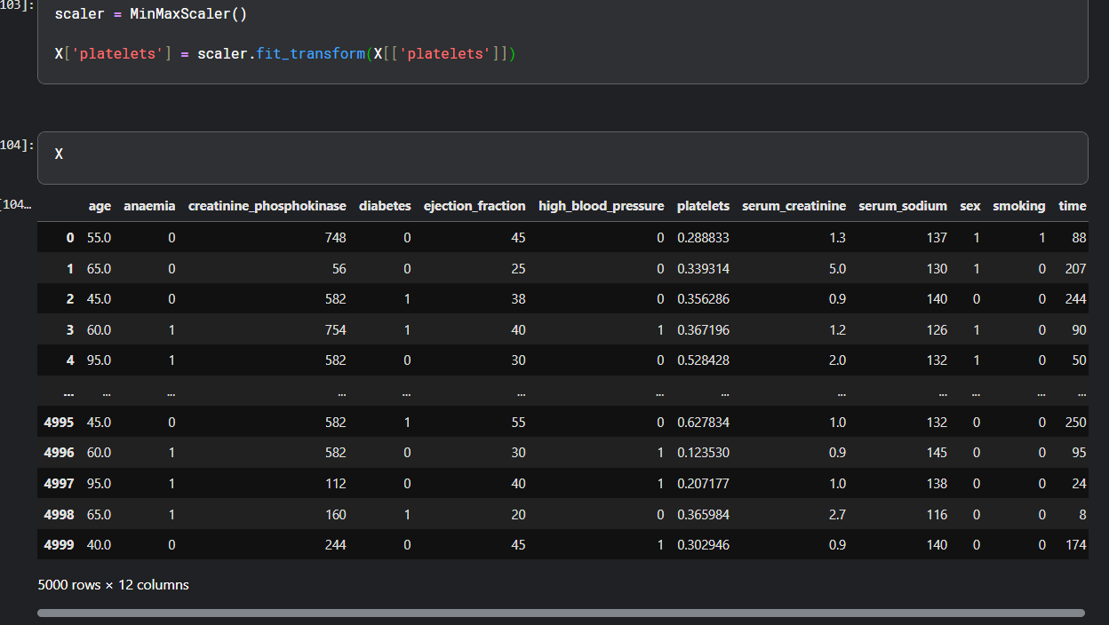
DATA SCALLING

Slide 27
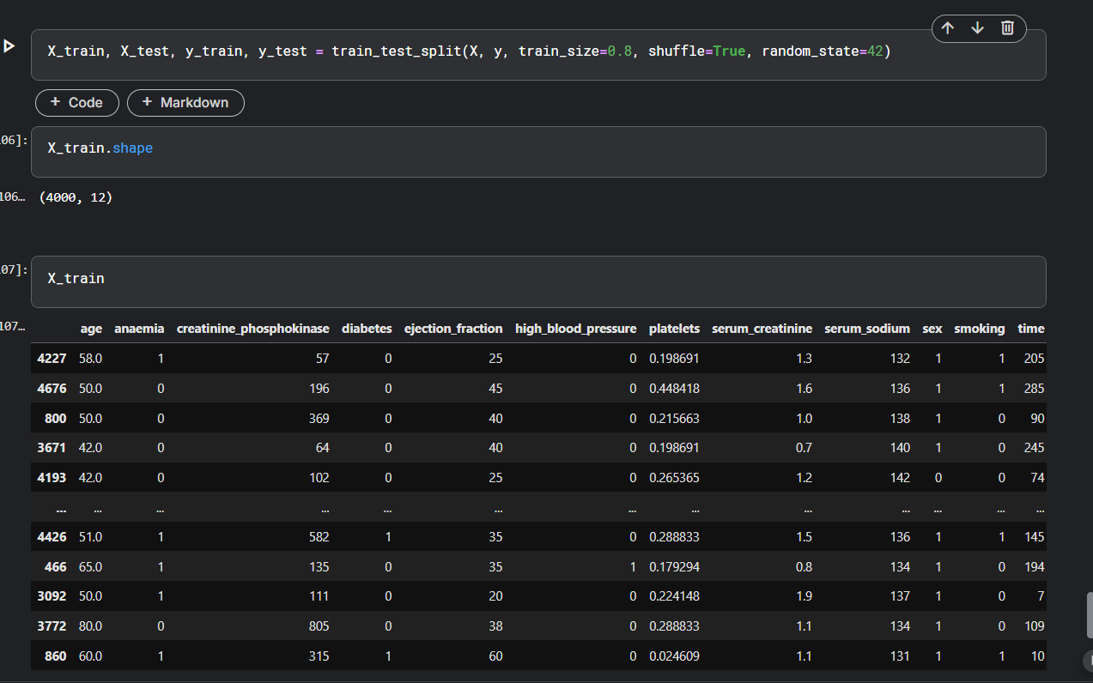
Data Splitting

Slide 28
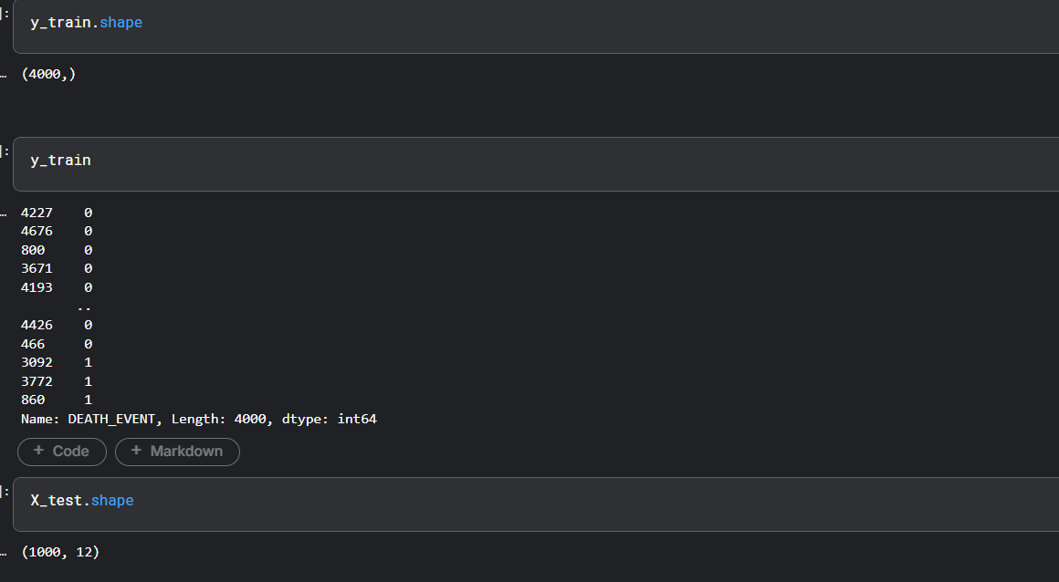
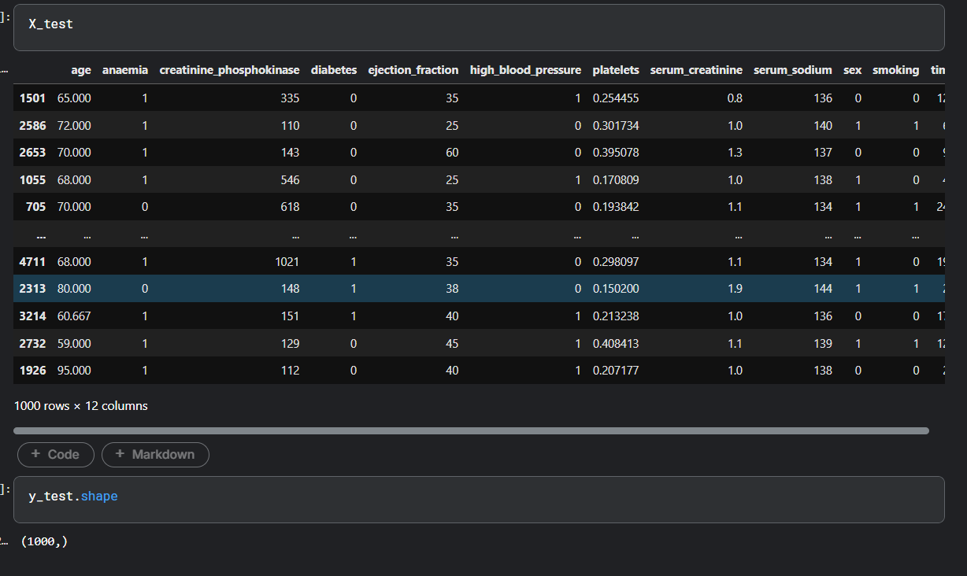
Data Splitting

Slide 29
Data Splitting

Slide 30
Data Splitting

Slide 31
Data Splitting

Slide 32
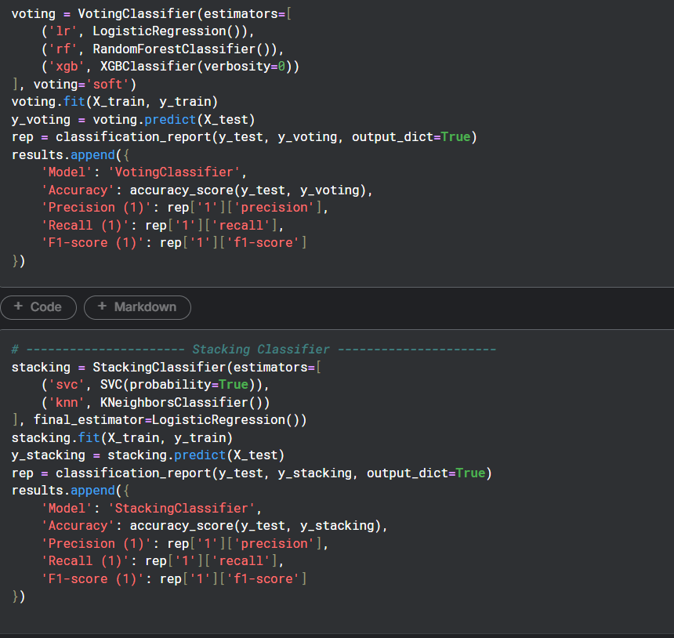
Data Modeling

Slide 33
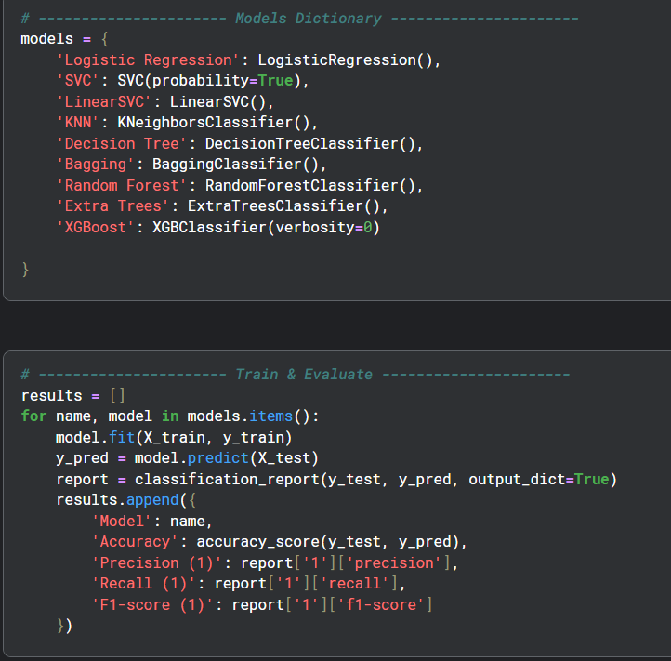
Data Modeling

Slide 34
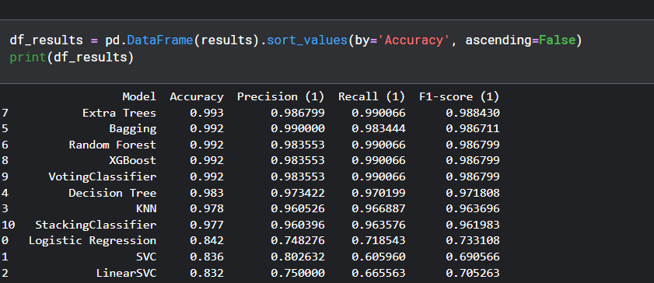
Data Modeling

Slide 35

THANK YOU

